Slide 1
IOT BASED SURVEILLANCE ROBOT
Under guidance of
Mr/Dr. Faculty,
Designation,
BIT,
Sathy.
Student 1 (202IT263 & VISHAL M )
Student 2 (202IT157 & KISHORE D)
Student 3 (202IT130 & DHARUN R)
Student 4 (202IT147 & JAYASUTHAN V)

Slide 2
Abstract
This project is to design and build a manually control IOT based surveillance robot. The purpose ofthe robot is to be able to roam around in a given environment while transmitting back realtime data (video)to the ground station over the internet or Wi-Fi. This real time data can then the used by the controller (human) to move the robot around. In this proposed system, the robot is compact and self-contained with wireless transmission of data. This system will help to control/spy on the terrorist attack throughout the world by monitoring and control of robot via the internet through Raspberry Pi board. The monitoring and controlling of robotic movements are done through the wireless network by using a web-based application.
Key Words: Raspberry Pi, Raspbian OS, Python, Things Board, Gas sensor, PIR sensor, Metal detector, Temp & humidity sensor…

Slide 3
Problem Statement Addressed
Raspberry Pi receives live data collected from differentsensors embedded with it and then transfer to Things boarddashboard using Wi-Fi. These different sensors areTemperature sensor ,humidity sensor, Metal Detectorsensor, Gas Sensor, PIR sensor and camera for live videostreaming. The monitoring and controlling of robot is doneby wireless network by using a web application Thingsboard. The camera is mounted on the robot to get bettervisibility of the objects nearby robot. Camera video transmission via internet is done using Duplicity framework.

Slide 4
Existing Solution to the Problem Addressed
We can use this system for military applications installing suitable sensors. Just by changing the robotic unit design we can use it in hospitals for patient monitoring. Using some chemical sensors we can detect harmful gas leakage in the chamber the time delay which occurs in the execution of commands can be reduced and thus we can have more real time access to the robot. With reduced time delay we can have faster operation and quick response to any illegal activities in the monitored area. Also it can be used as a spy robot. The robot is very economical.

Slide 5
Proposed Solution to the Problem Addressed
Robot is a machine which design to do particular task. It is based on program that is software and hardware. Now a days industry becoming modern and they use automated technology to perform risky jobs. This is helpful to minimize life risk of human and animals. For example security purpose we can use automated security system instead of animal/human to minimize life risk of animals. For home security, we use camera which is mounted on fixed location such as doors, windows, walls and ceiling also. This robot is control by using PC, android mobile or a laptop via website. The camera captures video and sends it back tocontroller’s device via internet.According to this paper our system helps to controls the terrorist attack anywhere on earth except water by monitoring and controlling of robot via internet through Raspberry Pi board. The monitoring and controlling of robot is done by wireless network by using a web application.

Slide 6
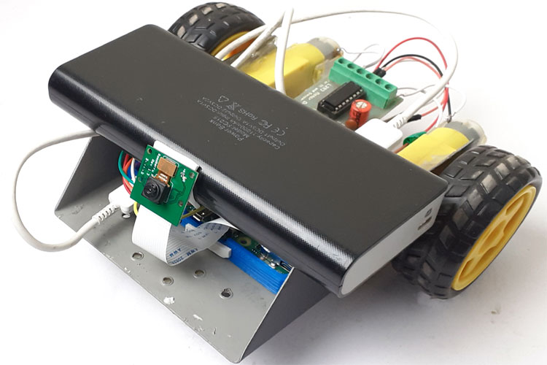
Project Work Plan
The block diagram of IOT Based Surveillance Robot is shownbelow. The main components of the system Raspberry Pi,,Gas sensor, PIR sensor, Metal detector ,Temp & humiditysensor, Power supply, Camera, Motor, Motor driver, Cloud.

Slide 7
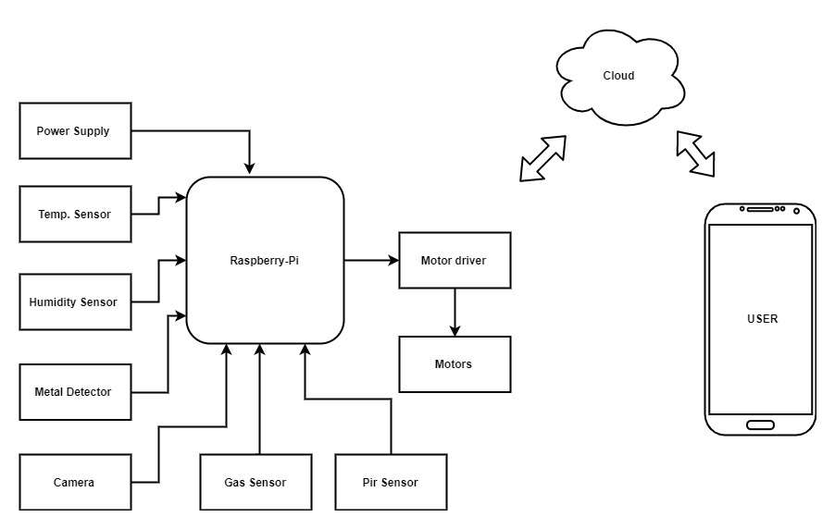
Block Diagram and/or Circuit Diagram

Slide 8
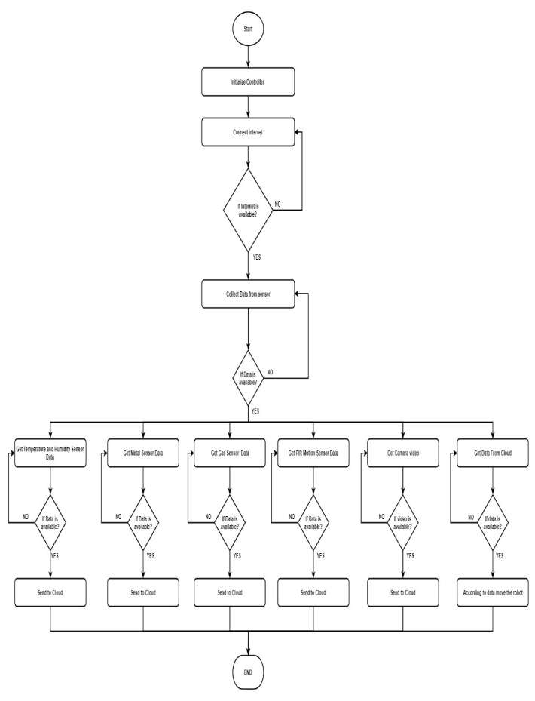
Flow Chart

Slide 9
Effective utilization of the Modern Tool & Cloud
Raspberry pi:
It is a small-card sized computer capable of performing various functionalities such as in surveillance systems, military application, industrial application, home application, etc. The specification of the raspberry pi 3 Model is ARM8-quad core processor 1200 MHz BroadcomBCM2837, HDMI support, 1GB Ram with the support of 4USB devices, and also micro SD card slot. The memory can further increased to a capacity of about 1GB .The 40 General Input output pins can be used to connect different types of connector with expansion boards also can be added. The fully backward compatibility is given to the first 26 identical pins on Model B board.
Features:
1. SOC: Broadcom BCM2837B0, Cortex-A53 (ARMv8)
64-bit
2. CPU: 1.4GHz 64-bit quad-core ARM Cortex-A53 CPU
3. RAM: 1GB LPDDR2 SDRAM
4. Thermal management: Yes
5. Video: Yes – Video Core IV 3D. Full-size HDMI
6. Audio: Yes
7. USB 2.0: 4 ports
8. GPIO: 40-pin
9. Power: 5V/2.5A DC power input
10. Operating system support: Linux and Unix

Slide 10
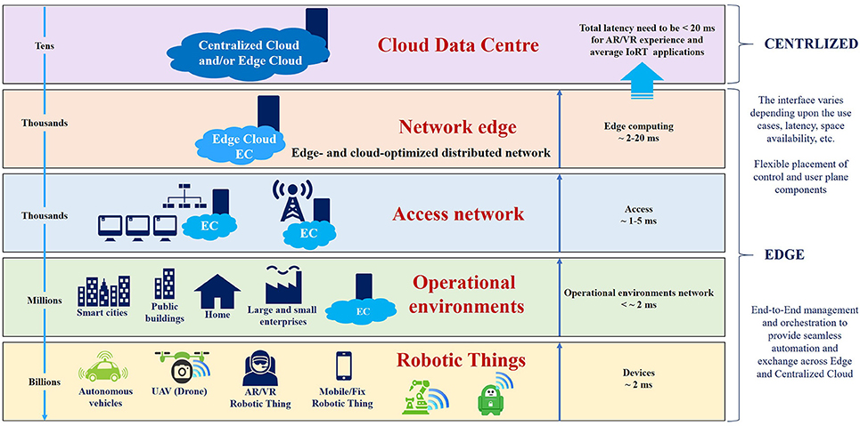
Technology stack & use case

Slide 11
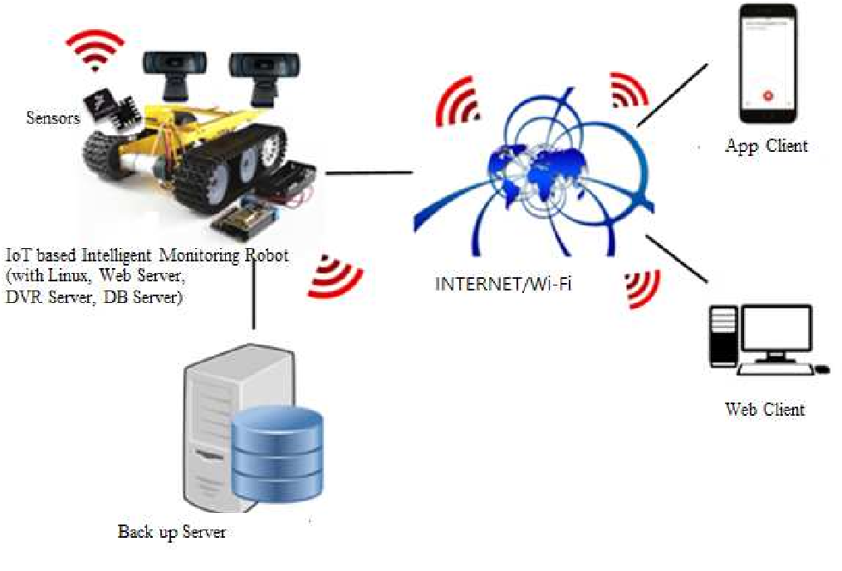
Prototype & Sample Output

Slide 12
Analysis of Results & Discussions
This system can be used for military applications by installing appropriate sensors. We may utilize it in hospitals for patient monitoring simply by modifying the architecture of the robotic unit. We can identify dangerous gas leaking in the chamber using chemical sensors, reducing the time delay in command execution and allowing us to have greater real-time access to the robot. We can operate more quickly and respond more quickly to any illegal actions in the monitored region if the time delay is decreased. It can also function as a spy robot. The robot is incredibly cost-effective.

Slide 13
Cost Benefit Analysis (List of Components / Service Used)
S.No | Component Name | Specification (IC number or Range or Value) | Unit Cost | Total Cost
1. | Raspberry Pi | 32 bits | - | 296.75
2. | Metal detector | S-15 | - | 3099.76
3. | PIR sensor | RA-4961-DSQ | - | 1800.00
4. | Temp and Humidity sensor | DFN-6 | - | 237.95
5. | Motor driver | L6622DP | - | 616.15

Slide 14
Working video Link (If available)
https://youtu.be/pD2VFKUlWC8

Slide 15
References
1] R. Karthikeyan, S. Karthik, Prasanna Vishal, S. Vignesh ‖
snitch design and development of a mobile robot for
surveillance and reconnaissance‖
IEEE Sponsored 2nd International Conference on
Innovations in Information Embedded and Communication
Systems ICIIECS’2015.
[2] Kun Wang, Zhiqiang Wang and Houxiang Zhang,
Development of modular wall-climbing robot inspired by
natural caterpillar‖ IEEE 2nd
International Conference on Computing, Control and
Industrial Engineering (CCIE), 2011.

